Slide 1

Chapter 5
Comparative and Quantitative Proteomics
Li-Qiang Fan
East China University of Science and Technolog

Slide 2
Proteomics
The study of an organism's proteome
A catalog of all proteins
Expressed throughout life
Expressed under all conditions
Study specific proteins
Differential expressed
Unknown protein of interest
The goals of proteomics
To catalog all proteins
To understand their functions/PTM/location
To understand how they interact with each other
To compare 2 conditions: normal vs. disease (qualitative and quantitative)
To identify unknown protein of interest

Slide 3
Differential Proteomics

Slide 4
Differential proteomics
Identify protein dynamic changes or behaves
Identify proteins whose abundance differs across two or more related samples
cell type
developmental stage
the cell state
stage of the cell cycle
environment
disease
normal skin vs. squamous(鳞状) cell carcinoma
Notes:
4
遗憾的是只有很少的蛋白质的表达量有显著的上调或下调，大多数情况下样品间蛋白质的表达量变化不大。
准确的蛋白质定量是蛋白质组学的一个关键环节
蛋白质组学研究的核心内容是蛋白质的动态变化和动态行为，即蛋白质的动态表达、动态定位、动态修饰和动态相互作用等，最终的研究目的是以大规模的尺度研究细胞内蛋白质的功能，这种研究要走向成熟必然要脱离对蛋白质的简单鉴定，实现对蛋白质的表达水平及其存在形式变化的检测。因此，定量技术应该说是整个蛋白质组学的精华部分。而这种定量通常不必是检测蛋白质在细胞内的绝对含量，而只需对其相对含量进行定量即可。

Slide 5
Differently expressed proteins
Disease markers
New therapeutic targets
Important proteins with related functions

Slide 6
Problems
Very few proteins can show unambiguous on/off changes
Difference between samples is one of degree
Need the quantification of difference!

Slide 7
Quantification methods
Individual protein
Many proteins in proteome scope
The Bradford assay
The direct spectrophotometric assay
BCA assay et al
Use of labeled antibodies –immunoassays
western blot
enzyme-linked immunosorbent assay (ELISA)
2DE-based
MS-based
high-through staining/labeling, selectively staining/labeling

Slide 8
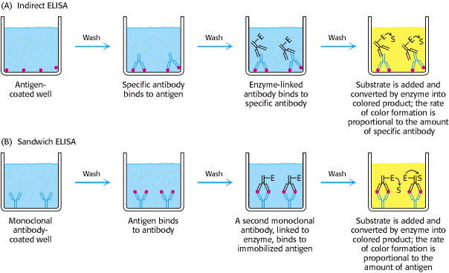
Use of labeled antibodies-- ELISA
Indirect ELISA and Sandwich ELISA (A) In indirect ELISA, the production of color indicates the amount of an antibody to a specific antigen. (B) In sandwich ELISA, the production of color indicates the quantity of antigen.

Slide 9
Differential Display and Quantification at Proteomic Level
2-D polyacrylamide gel electrophoresis based
Conventional gel
2D-DIGE(2D-different gel electrophoresis)
Two-in-one gel
MS based
Stable isotope labeling of proteins
Label free quantification

Slide 10
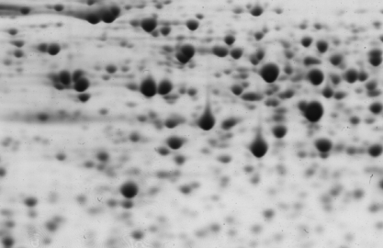
Conventional gel
-- Single Sample per Gel Technique
Control Tissue
Proteins
Treated Tissue
Proteins
Comparison of spot volume
2-D Gel Electrophoresis
Gel staining
Coomassie blue
Sypro ruby
Silver
Deep purple
Control
Treated
Gel matching

Slide 11
Normalization and quantification
The abundance of different proteins on a 2D-gel is determined by the shape, size, and intensity of the corresponding spots.
Hence, protein quantification requires the conversion of an analogue gel image into digital data, resulting in a catalog of individual spots listed as x/y positions, shape parameters and quantitative values (integrated spot intensities).

Slide 12
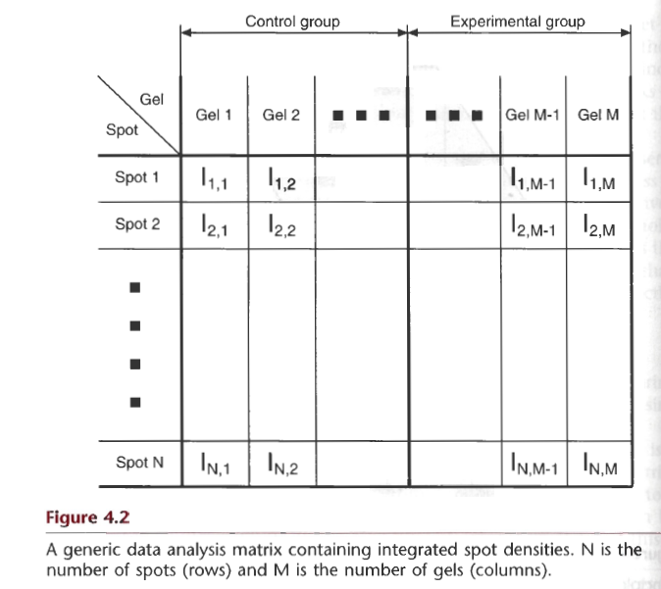
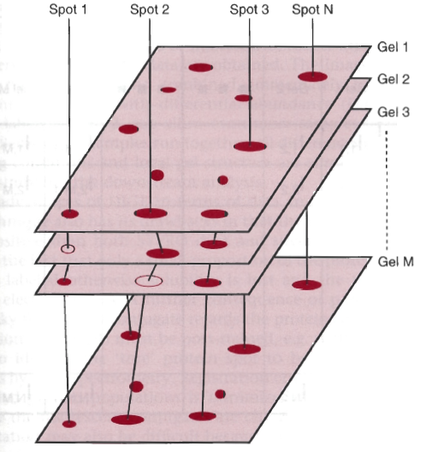
The end result is a table of spot values (x/y coordinates, shape parameters and integrated spot intensities) arranged as a N×M matrix where N represents all the different spots that have been identified and M represents all the gels.

Slide 13
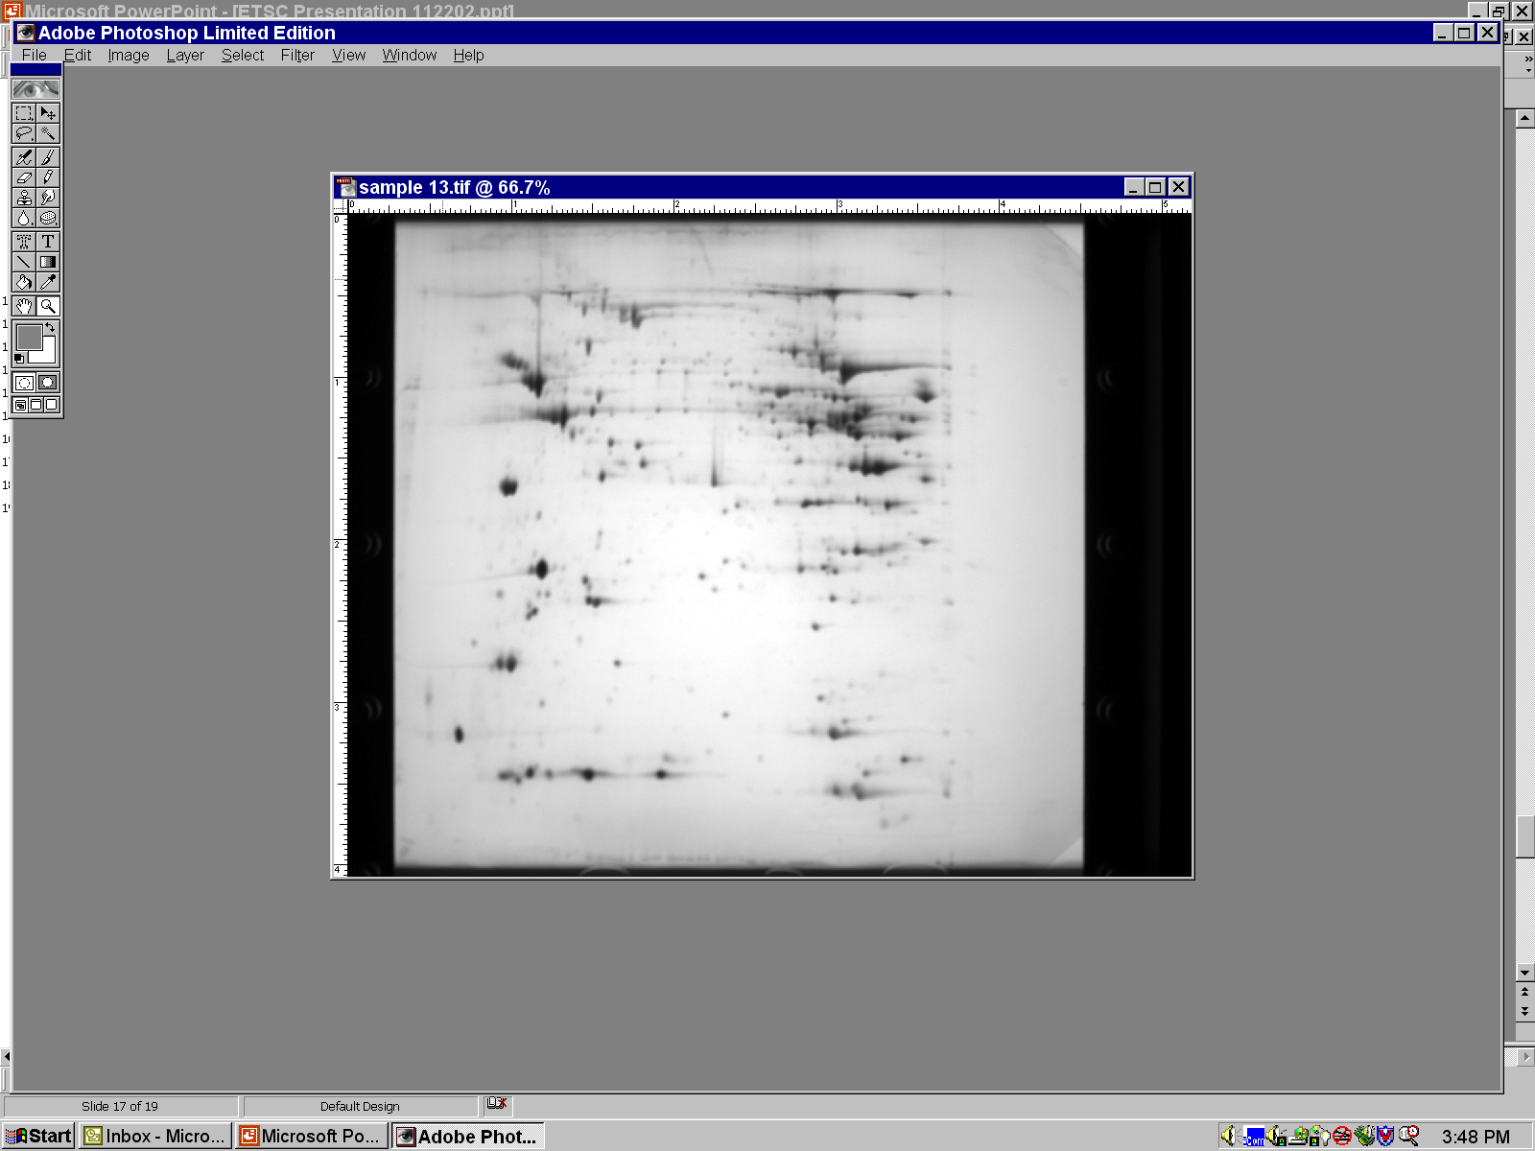
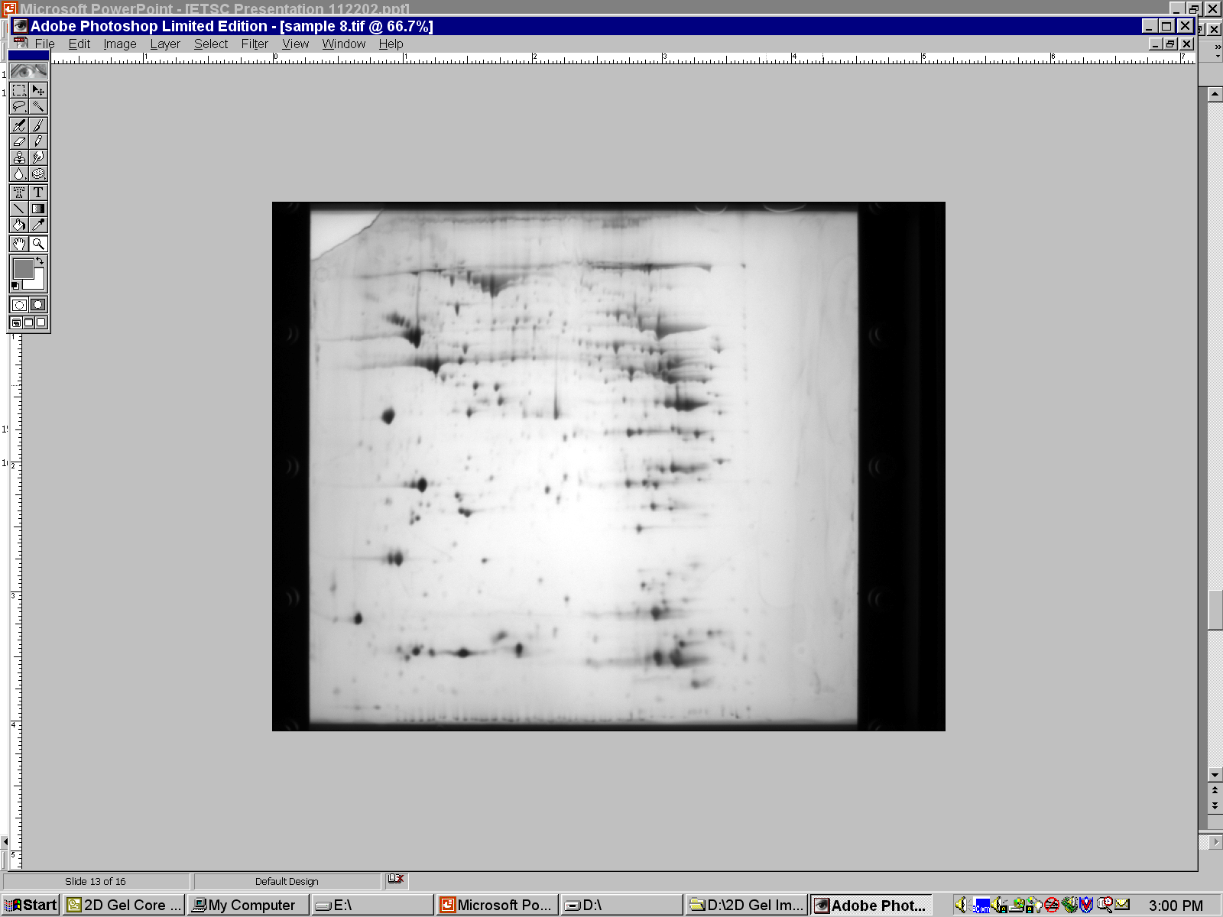
Control
Experimental
spod ID:S8-1
mouse cardiac; 250 μg loading; pH 3-10 IEF strips; 12.5% SDS-PAGE;
file ID: sc13con vs. sc08iso;
spot ID: S8-1

Slide 14
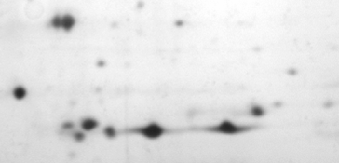
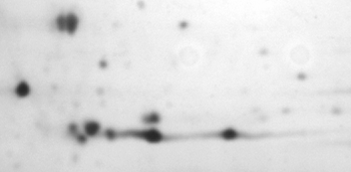
Control
Downregulation?
PTM?
Downregulation?
Experimental
mouse cardiac; 250 μg loading; pH 3-10 IEF strips; 12.5% SDS-PAGE;
file ID: sc13con vs. sc08iso;
spot ID: S8-1

Slide 15
DIGE (difference gel electrophoresis)
Built upon the classical gel approach to protein quantification (gel densitometry)
Allows the separation of treated (or diseased) and untreated (or control) samples in a single physical gel.
Quick comparison in the differences of the protein profiles of each sample by overlaying the unwrapped maps of treated and untreated samples. It is possible to see which proteins are shared by both, which are present in one sample but not in the other.

Slide 16
DIGE (difference gel electrophoresis)
In a DIGE system, proteins are pre-labelled with fluorescent CyDyes™ such as Cy3, and Cy5 prior to electrophoretic separations.
Labelled samples are mixed before isoelectric focusing, and resolved on the same 2D gel (ΔMW of proteins is negligible)
Quantitative Analysis is based on relative intensities of fluorescing labels at specific spots (relative quantification) or to labeled standard (absolute quantification).

Slide 17
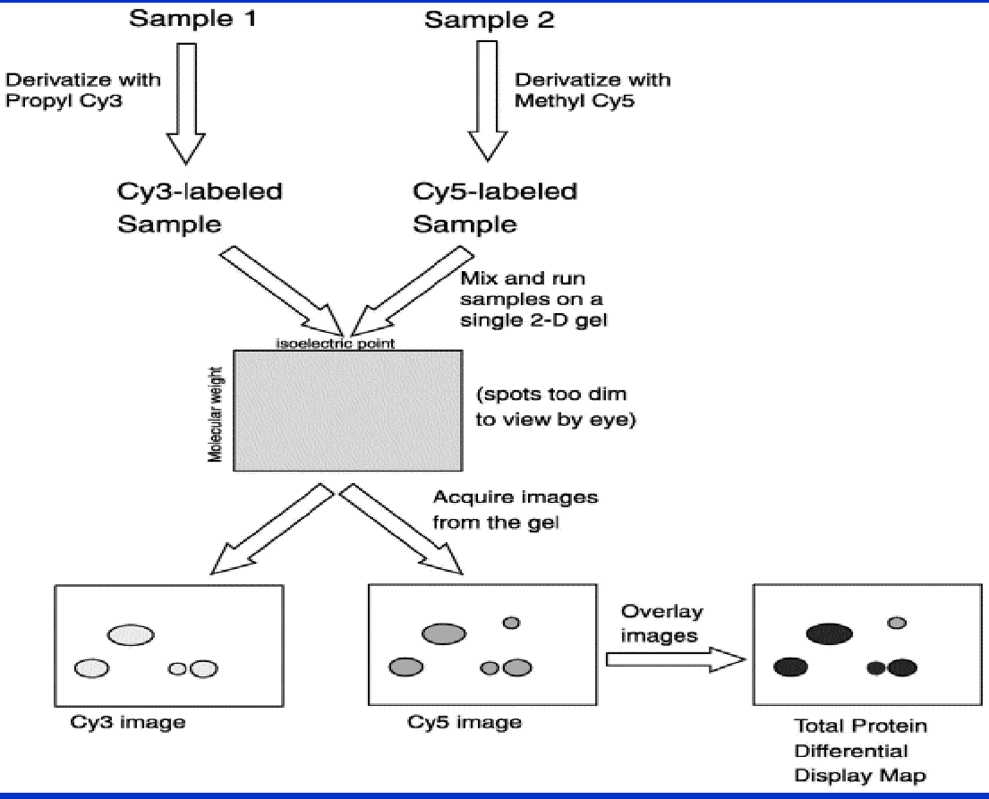

Slide 18
Key benefits:
More confidence- reflects true biological outcomes and is not due to the technical variation
Less gels- saves time by reducing the large number of replicates that are used in the conventional, single stain 2D gel method
High accuracy- no false negative and no false positive
Quantitative data
18

Slide 19
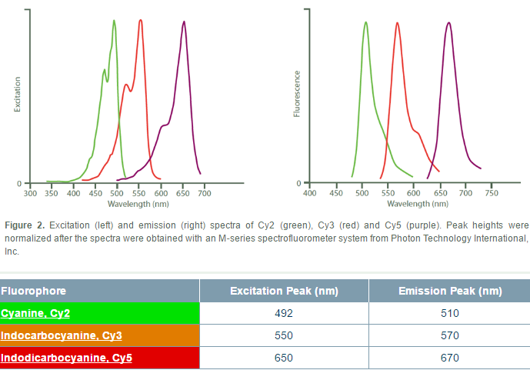
Sample labelling
Different cyanine（ 青色素 ）-based dyes
cyanine dyes: Cy2, Cy3 or Cy5
Notes:
saturation labelling is much more sensitive than the minimal one, as more dyes are covalently bound to proteins.
N-hydroxysuccinimidyl ester N-羟基酰亚胺酯

Slide 20
Sample labelling
Different cyanine（ 青色素 ）-based dyes
cyanine dyes: Cy2, Cy3 or Cy5
N-hydroxysuccinimidyl ester （ N-羟基酰亚胺酯 ）
thiol-reactive maleimide （ 马来酰亚胺 ）derivatives
Minimal labelling (50 μg protein: 400 pmol dyes)
N-hydroxysuccinimidyl ester Cy2,Cy3 or Cy5 reacts with free amino groups (amino-terminus and ε-amino groups of lysine residues)
only 2%–5% of the total lysine residues are labelled.
Saturation labelling
thiol-reactive maleimide derivatives of Cy3 or Cy5 reacts with free thiol groups of cysteine residues
all the cysteine residues are labelled
the thiol-free proteins will not be labelled
particularly adapted to low abundance proteins
Notes:
saturation labelling is much more sensitive than the minimal one, as more dyes are covalently bound to proteins.
N-hydroxysuccinimidyl ester N-羟基酰亚胺酯

Slide 21



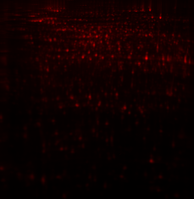
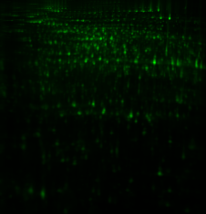
Relative quantification
2-D DIGE Chemistry
Control
Treated
Fluor
Label
Cy2
Cy2
Cy5
NHS ester active group
Mix
ice-water bath
+ protein
@ pH 8.5
2-D co-Separation
Fluor
Cy5
Imaging
lysine
NH
O
N
H
O
Cy2 + Cy5

Slide 22
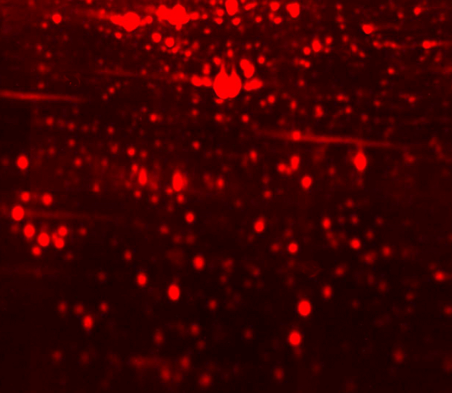
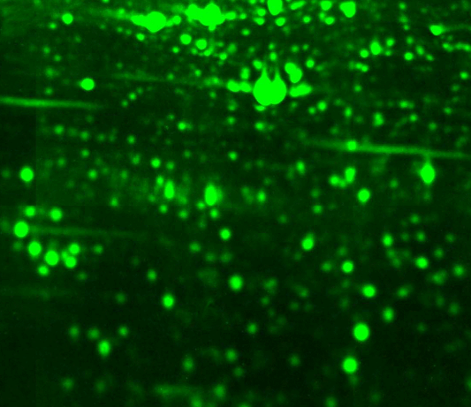
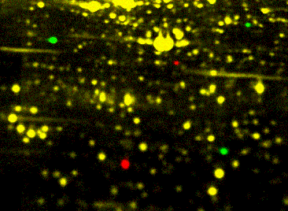
Sample A pre-labelled with dye A
Sample B pre-labelled with dye B
Differential View
Cy3
Cy5
Cy3/cy5 staining
Cy5
Cy2
Cy5/Cy2 staining
... 1 Gel, 2 Samples, 2 Dyes: More Data Reliability with Higher Speed!!
22

Slide 23
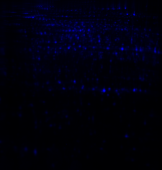
Absolute quantification
Internal Standard
Standard
Control
Treated
Labelling
Cy2
Cy3
Cy5
Mix samples
2-D Separation
Imaging
Image Analysis

Slide 24
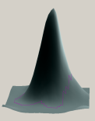
Absolute quantification
Gel imaging
1 gel = 3 linked images
Cy2, Cy3, Cy5
Co-detection of spots in all 3 samples
algorithm utilises pixel data from all 3 images
Gel matching utilises the internal standard
One Cy2 spot map designated master gel
Quantification is linked to the internal standard in each gel
raw spot volume of Cy3 and Cy5 is normalised against
corresponding Cy2 internal standard for each gel (i.e.
the normalised spot volume is the ratio Cy3/Cy2 or Cy5/Cy2)
Cy2
Cy2
Cy3
Cy5
Computation of normalised spot volume
Control = Cy3:Cy2 Treated = Cy5:Cy2
Spot detection
Gel matching
Spot quantification
Notes:
Small differences in expression levels can be determined by comparing the ratio obtained from one fluorescent-labeled sample directly with another.
It is possible to see < 10% differences in protein expression between samples, with > 95% statistical confidence.

Slide 25
8 sample 4 gels
Expt. Sample Dye
1 C-1 Cy3
2 C-2 Cy3
3 C-3 Cy3
4 C-4 Cy3
1 T-1 Cy5
2 T-2 Cy5
3 T-3 Cy5
4 T-4 Cy5
Pooled standard S Cy2
Replicate # 1
S
C1
T1
Replicate # 2
S
C2
T2
Replicate # 3
S
C3
T3
Replicate # 4
S
C4
T4
Common
standard
Notes:
Three technologies—SYPRO® Ruby protein gel stain, Pro-Q® Diamond phosphoprotein gel stain and the Pro-Q® Emerald glycoprotein stains—can be used individually or in series to detect total protein, phosphoproteins, and glycoproteins, respectivel

Slide 26
Minimze experimental variation
Experimental variation
System variation
Gel-to-gel variation, which can result from differences in electrophoretic conditions between first dimension strips or second dimension gels, gel distortions, sample application variation and user-to-user variation
Variation due to user-specific editing and interpretation when using the data analysis software
Inherent biological variation
Intrinsic differences that occur within a population.
For example, differences from animal-to-animal, plant-to-plant or culture-to-culture which have been subjected to identical conditions
Notes:
2D analysis experiments commonly address questions like protein level differences caused by a disease state, drug treatment, life-cycle stage etc.
Some protein level differences studied are small and the results are affected by

Slide 27
Experimental Design
Statistical data assay on differences between control and two treatment regimes A and B
For the control and two treatment regimes, four biological replicates are included .
The internal standard (a pool of equal amounts from all samples: four controls and eight treated) is labeled with CyDye DIGE Fluor Cy2 minimal dye and run on every 2-D gel.
Each control and treated sample is labeled with either CyDye DIGE Fluor Cy3 or Cy5 minimal dye and loaded on gels as indicated below

Slide 28
Gel | Cy2 | Cy3 | Cy5
1 | Pooled internal standard | Control 1 | Sample D
2 | Pooled internal standard | Control 2 | Sample C
3 | Pooled internal standard | Sample B | Control 3
4 | Pooled internal standard | Sample A | Control 4
5 | Pooled internal standard | Non-dye protein Control | Non-dye protein sample

Slide 29
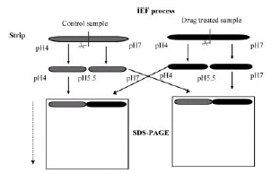
Two-in-one gel
1 An equal amount of a drug-treated and a control sample are first separated by IEF and the gel strip was cut in the middle.
2 strips with the same pH range were loaded side-by-side on top of a vertical SDS-PAGE slab gel for separation in the second dimension.

Slide 30
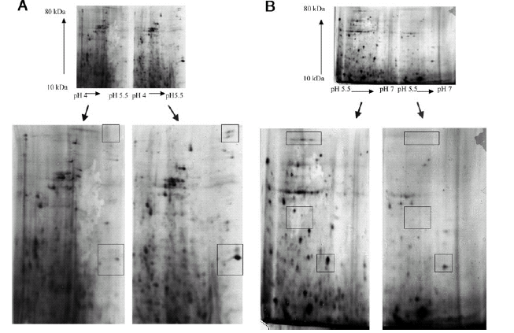

Slide 31
Advances
Avoid difference caused by different eletrophoretic conditions
Stain in one gel, avoid difference during stain
Alternative
Use two IPG strips with shorter length and narrower pH range
One for the control
The other one for the drug-treated sample.

Slide 32
Mass Spectrometry—based methods
E
Mass spectrometry is inherently not a quantitative technique.
The intensity of a peptide ion signal does not accurately reflect the amount of peptide in the sample.
equimolar mixture of 2 peptides
H
Q
A
B
Rel. Abund.
m/z
equimolar mixture of 2 peptides
(M+2H)²⁺ : [¹²C]-ion
Δ = 0.036
[Val⁵]-Angiotensin II
1031.5188 (monoisotopic)
Lys-des-Arg⁹-Bradykinin
1031.5552 (monoisotopic)
516.725
m/z
516.828

Slide 33
Mass Spectrometry and Quantitative Measurements
equimolar mixture of 2 peptides
E
H
Q
¹³C
¹³C
¹³C
A
B
²D
²D
H
E
Q
A
B
Rel. Abund.
m/z
Two peptides of identical chemical structure that differ in mass because they differ in isotopic composition are expected to generate identical specific signals in a mass spectrometer.
Methods coupling mass spectrometry and stable isotope tagging have been developed for quantitative proteomics.

Slide 34

MS based quantitative methods
Labeling quantification
Metabolic labeling—SILAC et al
Chemical labeling– ICAT and its derivatives
Enzymatic labeling---¹⁶O-to-¹⁸O exchange
Label free quantific ation
SELDI protein profiles
Peptide profiles

Slide 35
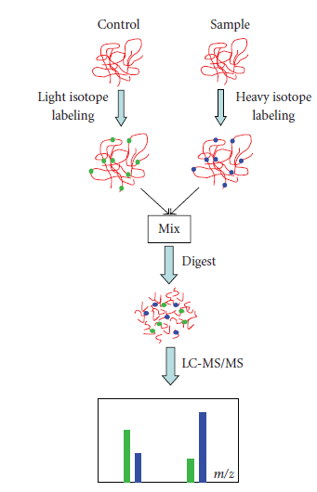
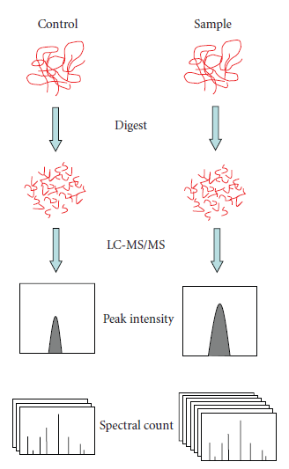
Qualitative Proteomics Label vs. Label-Free Methodology
35
Zhu, et. Al, Journal of Biomedicine and Biotechnology, 2010.

Slide 36
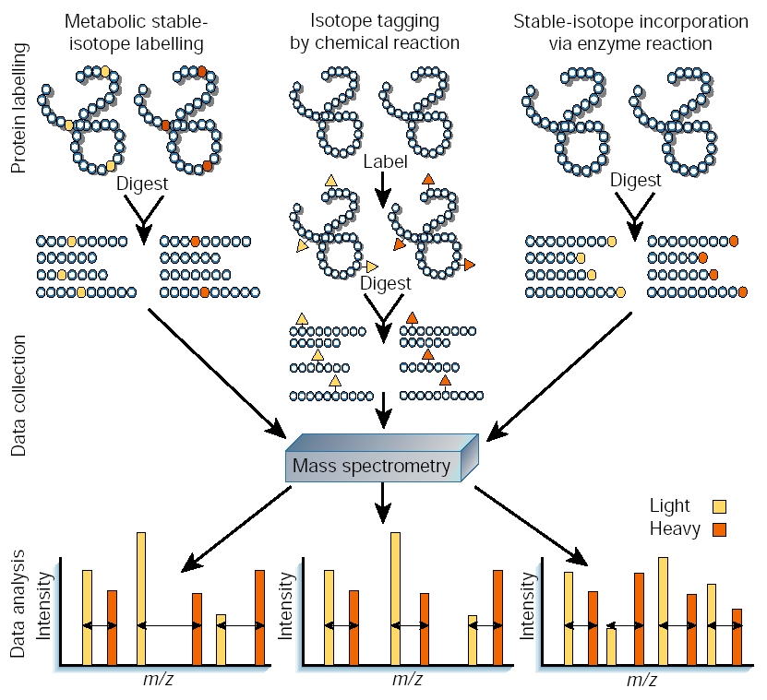
Stable Isotope Labeling
According to labeling method
Metabolic labeling
Chemical labeling
Enzymatic labeling

Slide 37
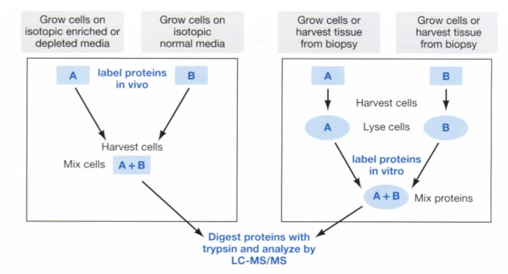
Stable Isotope Labeling Methods
In vivo labeling
In vitro labeling
体内标记:细胞或者个体在含有稳定同位素的介质中生长，稳定同位素被掺入合成的蛋白质，蛋白质被标记
体外标记：在体外采用化学反应将合成好的内标与蛋白质结合使蛋白被标记
Notes:
37
体内标记:是指细胞或者个体在含有稳定同位素的介质中生长，稳定同位素被掺入合成的蛋白质，从而充当了蛋白质定量的内部标准。常见的体内标记方法有15N体内代谢标记和细胞培养中稳定同位素标记氨基酸(Stable Isotope Labeling By Amino Acids In Cell Culture，SILAC)的方法。
15N体内代谢标记是用富含15N的介质来培养酵母、细菌和哺乳类等细胞，15N被掺入合成的蛋白质中，从而充当其定量的内部标准。蛋白质每掺入一个15N，所在的肽段将比正常14N的相同肽大一个质量单位，使得不同细胞状态来源的肽段得到区分，肽质谱峰信号成对出现，从而根据质谱峰的信号强度进行准确的定量。但
细胞培养中稳定同位素标记氨基酸的方法（SILAC）是2002年由Ong等人发明的一种体内标记定量技术，现已发展的比较成熟，应用广泛，主要操作流程如图2所示。这种方法就是在培养介质中加入稳定同位素标记的必需氨基酸，主要用于高等动物细胞中蛋白质的鉴定及定量。因为高等动物细胞的生长中需要一些必需氨基酸的摄入，如赖氨酸(Lys)、亮氨酸(Leu)、苯丙氨酸(Phe)等，而它本身无法合成这些必需氨基酸，需要从外界摄入补充。因此，在培养细胞时可以在培养介质中特异的加入用稳定同位素标记的某一种或者几种必需氨基酸，在经过适当的培养时间，细胞中的蛋白质被标记完全后，收获稳定同位素标记的细胞样品。
由于体内标记技术不能实现对不可培养的样本的定量分析，Ishihama等发明了一种拓展的SILAC技术，称为culture-derived isotope tags(CDITs)，如图2所示。该技术以稳定同位素标记的细胞样品为内标，实现了对实际疾病状态下组织样品的定量。
体外标记定量是指在体外采用化学反应将合成好的内标与蛋白质结合，这种方法由于增加了化学反应的步骤，会面临样品损失和标记不完全的问题，但是由于它使样品来源不再局限于培养的细胞或者个体，可以实现对实际疾病状态下的组织或体液样品进行定量分析，从而具有良好的发展前景。
根据标记的蛋白质部位不同，体外标记分为以下几种类型：N末端肽段标记，如iTRAQ；C末端肽段标记，如16O/18O标记策略；和一些特殊氨基酸标记，如半胱氨酸（cysteine）标记ICAT策略等。

Slide 38
Metabolic / in vivo labeling
Cells A
mix
extraction
reduction
alkylation
digestion
Cells B
separation
Enriched Medium (¹³C, ¹⁵N or amino acid with deuterium)
MS IDENTIFICATION and QUANTITATION
The organism under investigation is fed with stable isotope labeled versions of metabolic precursors such as amino acids, carbohydrates or organic salts in the respective growth media, which induces stable isotopes in proteins.
Oda Y, et al. P Natl. Acad. Sci. USA 96 6591-6596 (1999)
Pasa-Tolic L, et al. J Am Chem. Soc. 121 7949-7950 (1999)

Slide 39
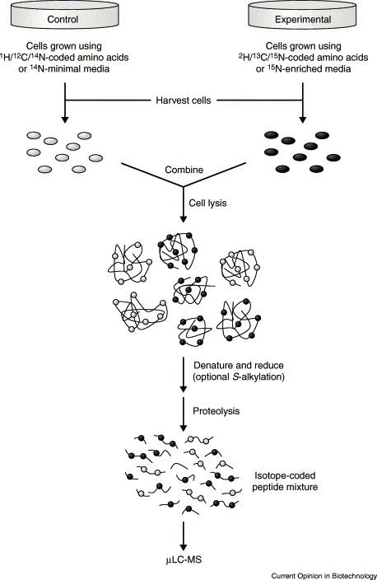
Metabolic labeling —in vivo labeling
Cells or individuals are grown in a medium rich in stable isotopes or in a medium containing stable isotopes labeled amino acids. Stable isotopes incorporate synthesized proteins during the metabolic process of cells or individuals, so that proteins are labeled.
Types:
Stable Isotope Labeling By isotope-rich medium
Stable Isotope Labeling By Amino Acids In Cell Culture，SILAC

Slide 40
Metabolic Labeling
isotope-rich medium (usually ¹⁵N or ¹³C)
Often used in Microorganisms
amino acid with isotope deuterium--SILAC (Stable isotope labeling with amino acids in cell culture)
Often used in Mammalian cell lines
¹⁴N-rich culture medium(¹⁴N 99.6%, ¹⁵N 0.4%)
¹⁵N-rich culture medium(¹⁵N>96%)
¹³C-rich culture medium
¹²C-rich culture medium
¹³C- and ¹²C-Lysine (heavy – light = 6 D)
¹³C- and ¹²C-Arginine (heavy – light = 6 D)

Slide 41
Typical SILAC experiment workflow
Upregulated protein - Peptide ratio >1
State A
State B
Light Isotope
Heavy Isotope
Mix 1:1
Optional Protein Fractionation
Background protein - Peptide ratio 1:1
Digest with Trypsin
Protein Identification and Quantitation by LC-MS
Ong et al., Mol. Cell. Proteomics 1, 2002.

Slide 42
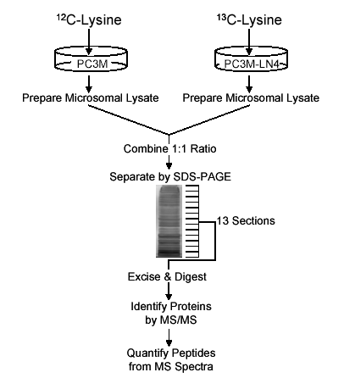
Example
(98%)
Prostate cancer cell line PC3
PC3M
(low metastatic potential)
PC3M-LN4
(high metastatic potential)
What kind of labeling method is it?

Slide 43
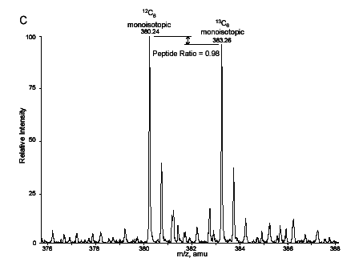
Check Labeling Efficiency of both isotopes
Ratio = 0.98
Control of SILAC peptide (IISLDAK) pair from glutamyl-propyl tRNA synthetase.
PC3M cells were cultured under both C12 and C13 conditions.
Equal amount of proteins was mixed for SILAC.

Slide 44
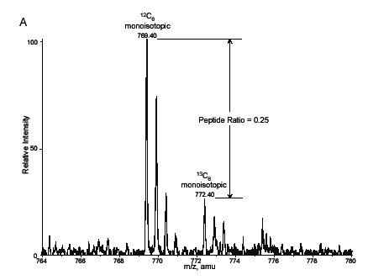
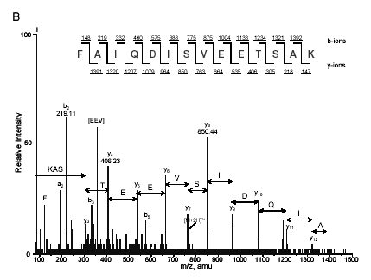
Difference of I_{o} and I₆ = 3 mass units → [M+H] ²⁺
Mascot → MSQuant
Ratio: areas of monoisotopic peaks
Figure 3. Identification and quantification of SILAC peptides
Everley et al., MCP 2004 http://msquant.sourceforge.net

Slide 45
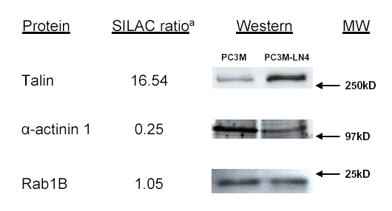
Immunoblots of selected proteins from microsomal lysates of PC3M and PC3M-LN4 cell lines
Everley et al., MCP 2004

Slide 46
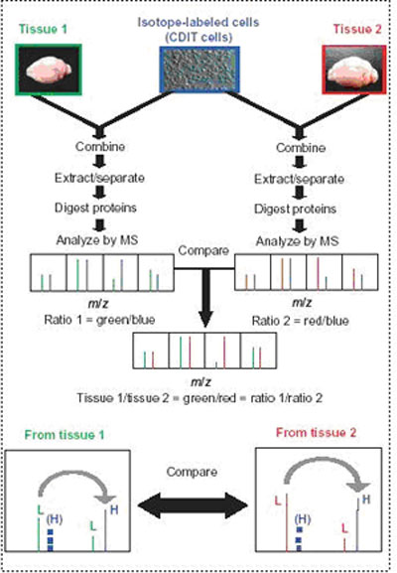
Culture-derived isotope tags (CDITs)
Extended SILAC Technology
Ishihama et al developed
The problem that tissue samples can not be labeled in vivo was solved

Slide 47
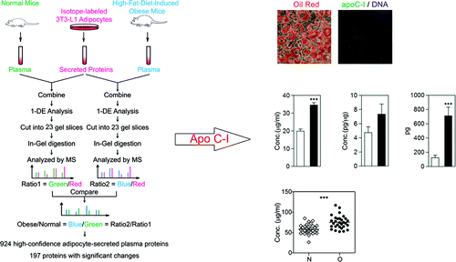
Secretome-derived isotope tags (SDITs)
Secretome-Derived Isotope Tags (SDIT) Reveal Adipocyte-Derived Apolipoprotein C-I as a Predictive Marker for Cardiovascular Disease J. Proteome Res., 2012, 11 (5), pp 2851–2862
DOI: 10.1021/pr201224e

Slide 48
Stable Isotope Labeling
According to labeling method
Metabolic labeling
Chemical labeling
Enzymatic labeling

Slide 49
Chemical Labeling —in vitro labeling
Isotope Coded Affinity Tag (ICAT)
ICAT derivatives
Isobaric mass tags
TMT
Notes:
49
体外标记定量是指在体外采用化学反应将合成好的内标与蛋白质结合

Slide 50
Isotope Coded Affinity Tag (ICAT)
Heavy reagent: d8-ICAT ( X = deuterium )
Light reagent: d0-ICAT ( X = hydrogen )
+ 442.2 or 450.2
O
N
N
O
O
X
X
X
X
O
I
S
H
cys
N
O
O
N
S
X
X
X
X
Affinity tag
Isotope-coded linker
protein reactive group
Thiol specific reactive group
biotin tag
Gygi et al. Nature Biotech, 17:994, 1999
Notes:
50
1999年，Gygi等人用化学方法合成一种能和半胱氨酸反应的亲和试剂，称为稳定同位素编码的亲和标签，它有轻链和重链(稳定重同位素)两种形式，可以在体外标记不同状态下的蛋白质样品，酶解并用亲和柱分离纯化被标记的肽段后，再用质谱进行分析，和体内标记法一样也能够得到成对的峰表示不同样品中肽段及对应蛋白质含量的差异。这种稳定同位素亲和标签技术可以广泛地应用在细胞和组织的定量蛋白质组学分析上，提供精确的蛋白质相对定量数据。

Slide 51
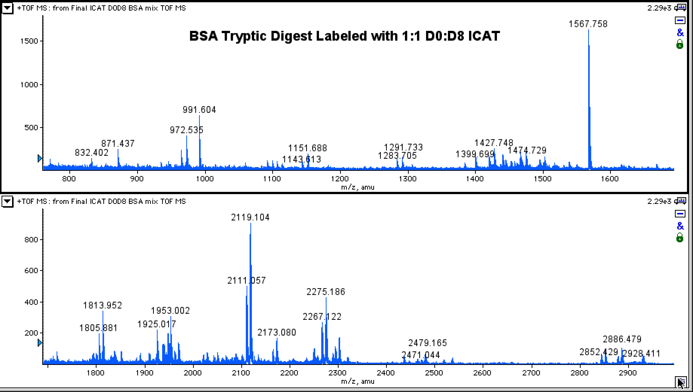
The ICAT strategy
ICAT-D₀
Cells A
Tryptic digestion
Protein extraction
Reduction
Alkylation
MIX
Cells B
Affinity Column
(avidin)
ICAT-D₈
LC-MS
Notes:
51
The Cys-residues in sample 1 is labeled with d0-ICAT and sample 2 is labeled with d8-ICAT.
The combined samples are digested, and the biotinylated ICAT-labeled peptides are enriched by avidin affinity chromatography and analyzed by LC-MS/MS.
Each Cys-peptide appears as a pair of signals differing by the mass differential encoded in the tag. The ratio of the signal intensities indicates the abundance ratio of the protein from which the peptide originates.

Slide 52
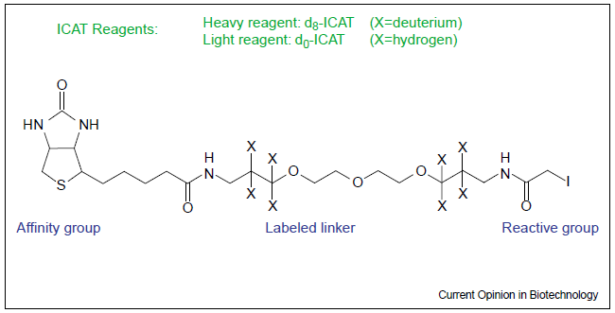
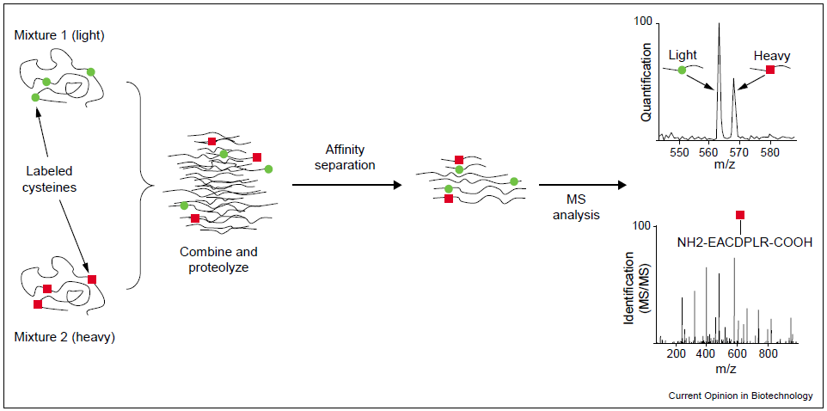
Qualitative Proteomics --ICAT Methodology
52
Tao, et. Al. Current Opinion in Biotechnology, 2003

Slide 53
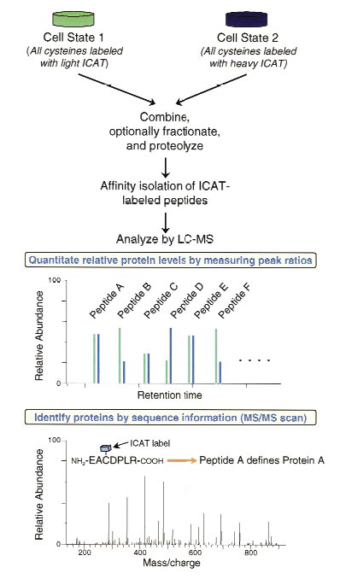
ICAT Procedure
Cell States
Normal vs. Diseased
Aerobic cells vs. Anaerobic cells
Lyse cell and digest with trypsin
Avidin-Biotin Separation
Single MS
Analyze peptide peak ratios
Tandem MS
Obtain sequence info from CID
Notes:
53
The ICAT strategy for quantifying differential protein expression.
Two protein mixtures representing two different cell states have been treated with the isotopically light and heavy ICAT reagents, respectively
an ICAT reagent is covalently attached to each cysteinyl residue in every protein
The protein mixtures are combined and proteolyzed to peptides, and ICAT-labeled peptides are isolated utilizing the biotin tag.
These peptides are separated by microcapillary high-performance liquid chromatography.
A pair of ICAT-labeled peptides are chemically identical and are easily visualized because they essentially coelute, and there is an 8 Da mass difference measured in a scanning mass spectrometer (four m/z units difference for a doubly charged ion).
The ratios of the original amounts of proteins from the two cell states are strictly maintained in the peptide fragments. The relative quantification is determined by the ratio of the peptide pairs. Every other scan is devoted to fragmenting and then recording sequence information about an eluting peptide (tandem mass spectrum). The protein is identified by computer-searching the recorded sequence information against large protein databases.

Slide 54
SILAC vs. ICAT
Culture system only
De Novo synthetic proteins
No optimization need
Simplifies MS/MS
More complete peptide coverage
ALL protein samples
Labels selected moieties
Need to optimize labeling
Large linker group.
Reduces complexity by affinity tags

Slide 55
Problems with ICAT
Expensive (~ $ 500/sample)
Selectivity for cysteine only (~8% peptides contain Cys)
The tag is bulky (+ 442.2 or + 450.2 mass unit)
Chromatographic property of heavy (deuterium) and light (hydrogen) ICAT labeled peptides are not identical.
Low recovery of labeled peptides（complicate labeling procedure）
Quantitative accuracy (?) ...+/- 10%

Slide 56




Developing ICAT
Tag is too big
Cleavable ICAT
Low recovery
Increase reaction efficiency
Purification
Solid phase ICAT
Replace affinity tag
Selectivity for cysteine
Other labeling reagent

Slide 57
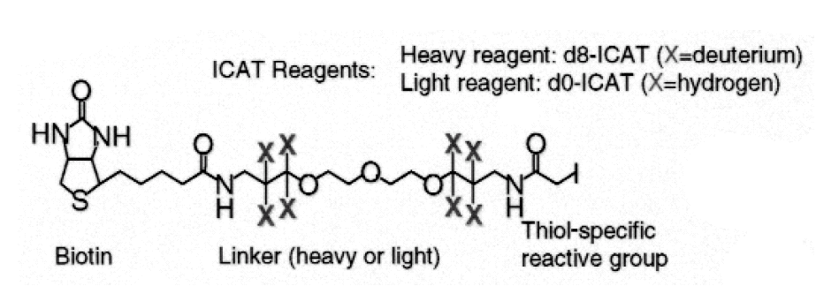
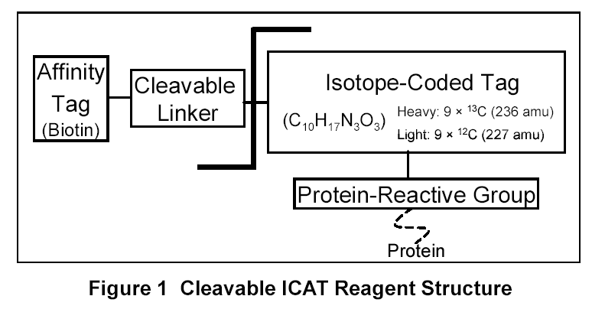
Acid Cleavable ICAT Reagents（cICAT）
Original ICAT
442 Da
Cleavable ICAT
227 Da
http://docs.appliedbiosystems.com/pebiodocs/04345222.pdf

Slide 58
Acid cleavable ICAT
Cysteine Reactive
Group
C¹² Chain
Acid Cleavage
Site
Biotin Tag
C¹³ Chain

Slide 59

Other cleavable ICAT
Photo cleavable ICAT
Insert an trypsin site on linker

Slide 60



Low recovery
Increase reaction efficiency
Labelling cysteine with vinylpyridine instead of iodoacetamide did not affect the function of other groups, but the modification rate of cysteine was increased to 100%.

Slide 61
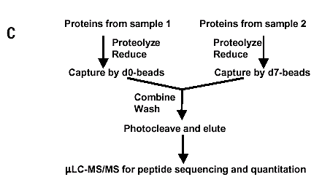
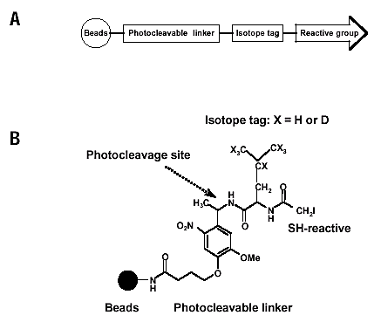
Solid phase ICAT
Zhou et al. Nature Biotechnology 20, 512 - 515 (2002)

Slide 62
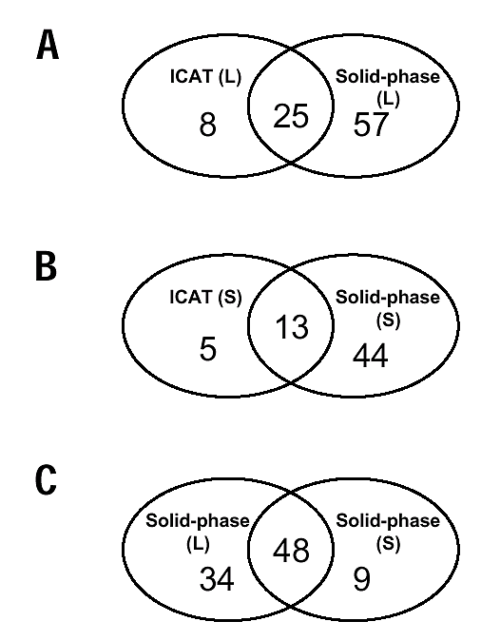
Solid-phase and ICAT methods
Number of proteins identified from large-scale experiment (L), in which 100 μg total protein sample was labeled and 20 μg was analyzed by LC-MS/MS
Number of proteins identified from small-scale experiment (S), in which 10 μg of total sample was labeled and 5 μg analyzed.
Number of proteins identified by the solid-phase method in large-scale (L) and small-scale (S) experiment.
Zhou et al. Nature Biotechnology 20, 512 - 515 (2002)

Slide 63




Replace affinity tag
His affinity tag replace biotin tag
GST affinity tag replace biotin tag

Slide 64


Non Cys-specific ICATs
MCAT—lysine labeling
Modification of Lys Peptide by Oxymethyl Isourea Sulfate into High Arginine (MW+42)
2-methoxy-4,5-dihydro-1-imidazole labeled epsilon-amino group of Lys peptide to make it 4,5-dihydro-1-hydro-1-imidazole-2-hydroxyl (labeled with hydrogen and deuterium respectively, with a difference of 4Da)
Notes:
64
C端为Lys的肽段（Lys肽）在MALDI中的例子信号明显低于C端为Arg的肽段，而胰蛋白酶消化产物都是Lys肽或Arg肽.

Slide 65

Non Cys-specific ICATs
Tryptophan labeling 色氨酸标记
2-nitrophenyl thiochlorine (2-硝基苯基硫氯) (NBS^{13C}/NBS^{12C})
Under mild conditions: Trp + Cys
Under acidic conditions: Trp > Cys, and labeled Cys can be replaced by iodoethylamine.
6Dadifferent
Separation of cationic or hydrophobic columns
Simple, effective and accurate quantitative method, but not suitable for tryptophan-free samples
Notes:
65
C端为Lys的肽段（Lys肽）在MALDI中的例子信号明显低于C端为Arg的肽段，而胰蛋白酶消化产物都是Lys肽或Arg肽.

Slide 66


Non Cys-specific ICATs
N-terminal labeling N-末端标记
N-terminal+Lys+Arg of peptide segment
Reagents Easily Acylated with Small Molecules Containing Acyloxy Groups
Carboxyl labeling 羧基标记
C-terminal+Asp+Glu of peptide segment
Carboxyl lipid labeling
Notes:
Comparative and Quantitative Global Proteomics Approaches: An Overview Proteomes. 2013 Dec; 1(3): 180–218.

Slide 67
ICAT Movies
http://www.bio.davidson.edu/courses/genomics/ICAT/ICAT.html (animation)
http://www.chemsoc.org/exemplarchem/entries/2002/proteomics/icat.htm (short movie)

Slide 68




Chemical labeling
Thiol label
ICAT, Iodoacetic acid, 4-vinylpyridine
Amine reagents
iTRAQ,TMT, Guanilidation, formaldehyde (dimethylation), aceticanhydride
Carboxyl end of peptides
Methanol (in acidic HCl), enzyme-catalysed 18O-labelling (enzyme mediated oxygen substitution,EMOS), acid mediated oxygen substitution (AMOS)

Slide 69
Reactive groups | Methods | Targets | Amino Acids | nb of samples | References
Thiol | ICAT | proteins | cysteine | 2 | [83]
 | ALICE | proteins | cysteine | 2 | [97]
 | Photocleavable-ICAT | proteins | cysteine | 2 | [98]
 | N-ethymaleimide/iodoacetamide | proteins | cysteine | 2 | [99]
 | acrylamide or vinylpyridine | proteins | cysteine | 2 | [100,101]
Amino | ICPL | proteins | N-term/Lys | 2,3,4 | [102,103]
 | Post-digest ICPL | peptides | N-term/Lys | 2 | [104]
 | iTRAQ | peptides | N-term/Lys | 2,4,8 | [105]
 |  | /proteins |  |  | [106]
 | TMT | peptides | N-term/Lys | 2,6 | [107]
 | Dimethyl | peptides | N-term/Lys | 2,4 | [108,109]
Carboxyl | EMOS | proteins | C-term | 2 | [110,111,112]
 |  | peptides | C-term | 2 | [113]
 | AMOS | peptides | C-term | 2 | [114]
 | Methanol | peptides | C-term /Asp/Glu | 2 | [115]
Comparative and Quantitative Global Proteomics Approaches: An Overview Proteomes. 2013 Dec; 1(3): 180–218.

Slide 70
Chemical Labeling: --Glycosylated protein profiling
Identification and quantification of N-linked glycoproteins using hydrazide chemistry, stable isotope labeling and mass spectrometry
Hui Zhang, Xiao-jun Li, Daniel B Martin & Ruedi Aebersold
Nature Biotechnology 21:660 - 666, 2003

Slide 71
Chemical Labeling: --phosphorylated protein profiling
PhIAT (phosphorprotein Isotope-affinity tags)
PhIST (phosphorprotein Isotope-coded solid-phase tags)
References:
Zhou, H. et al. A systematic approach to the analysis of protein phosphorylation. Nat. Biotechnol.2001, 19: 375–378
Goshe, M.B. et al. Phosphoprotein isotope-coded affinity tag approach for isolating and quantitating phosphopeptides in proteome-wide analyses. Anal. Chem. 2001, 73: 2578–2586
Rrandi L, Grant-Branum, et al Labeling strategies in Mass Spectrometry-based protein quantatition. Analyst. 2009, 134:1525-1530

Slide 72
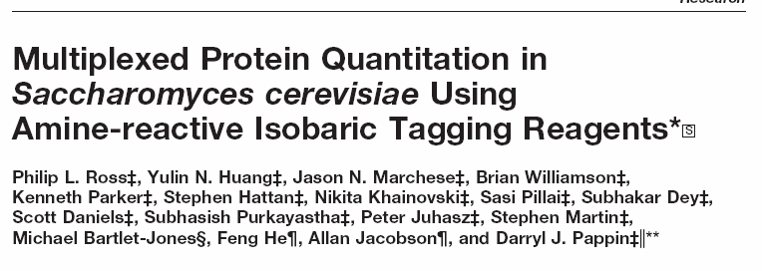


Amine-reactive reagent -- Isobaric tags
Reagents that bind covalently to the N-terminus of the peptide and any Lysine side chains at the anime group
One of the global tagging reagent

Slide 73

Isobaric tag reagent
Isobaric Tag (Total mass =145 Da)
Peptide reactive group
Reporter
mass=114 to 117
Gives strong signature ion in MS/MS
Good b- and y-series
Maintains charge state and ion masses
Signature ion masses lie in quiet low mass region
Balance
mass 31 to 28
Balances the mass change of reporter to maintain a total mass of 145
Neutral loss in MS/MS
Amine specific
Allows to compare the relative abundance of proteins from four different samples in a single mass spectrometry experiment

Slide 74
Isobaric tags
four different derivatives have the same total mass

Slide 75
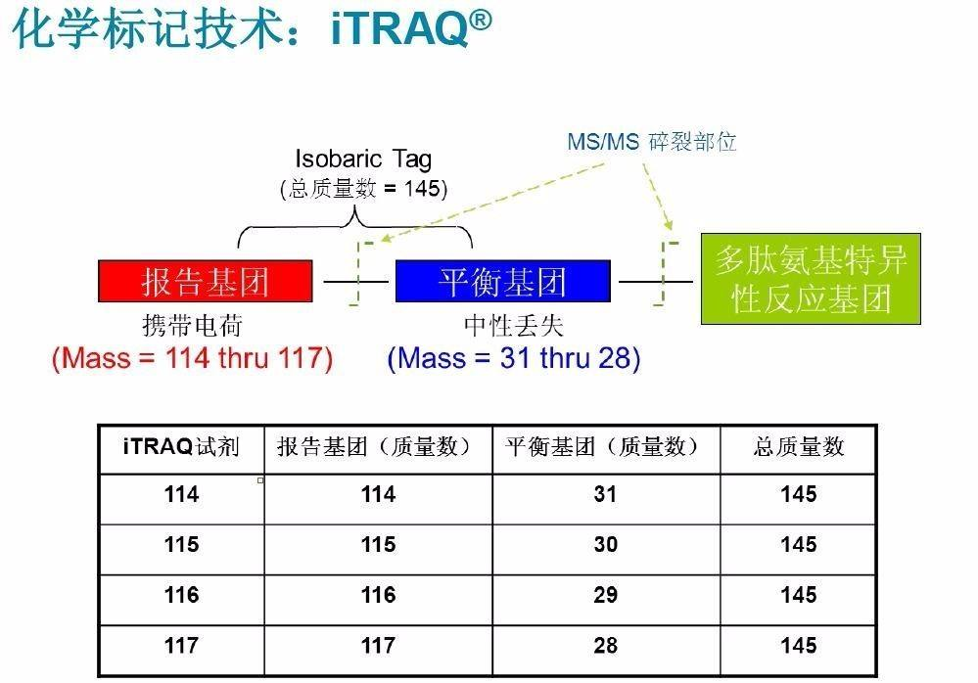

Slide 76
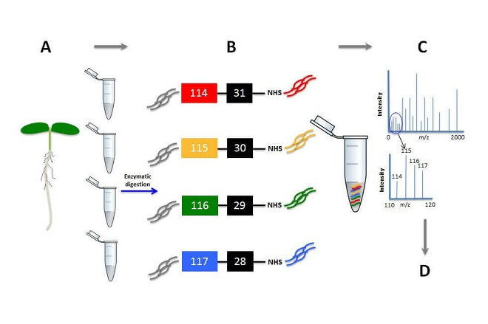

Slide 77
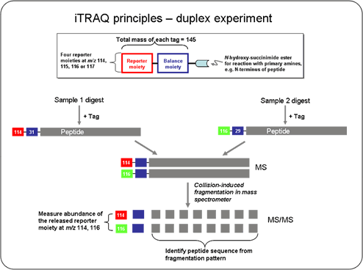
Isobaric tags for relative and absolute quantitation (iTRAQ)

Slide 78
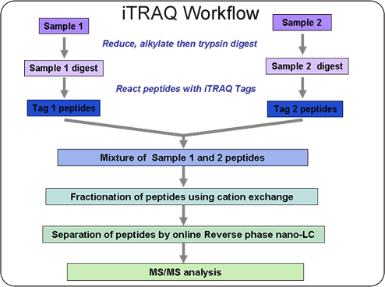
Isobaric Tag for Relative and Absolute
Quantitation , iTRAQ
78

Slide 79
Isobaric tags for relative and absolute quantitation (iTRAQ)
Uses up to 4 tag reagents that bind covalently to the N-terminus of the peptide and any Lysine side chains at the anime group (global tagging).
Digest and labelling
Each sample set is digested separately and then mixed with the specific iTRAQ tag
A
B
C
D
DIGEST
DIGEST
DIGEST
DIGEST
Label A
Label B
Label C
Label D
Notes:
79
Globally code N-termini and Lys residues of all peptides in
a tryptic digest through acylation with N-methyl hydroxy
succinamide esters of N-methyl piperazines
C. Fenselau J. Chromatogr. B 855 (2007) 14–20

Slide 80
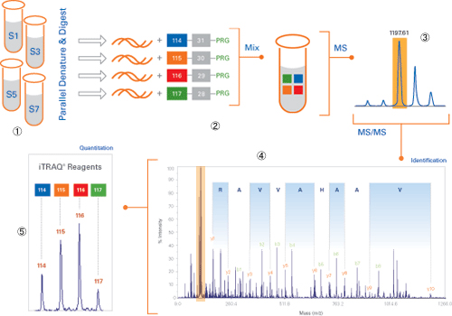
Isobaric Tag for Relative and Absolute
Quantitation , iTRAQ
80

Slide 81
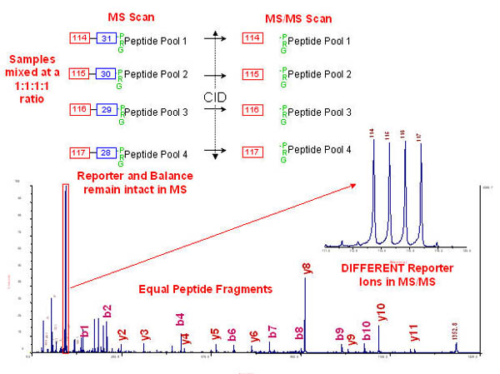
Combine the samples
LC-MS/MS

Slide 82
iTRAQ
114
31
NHS + peptide
Samples mixed
Reporter – Balance - Peptide intact
4 samples identical m/z
MS
115
30
NHS + peptide
116
29
NHS + peptide
117
28
NHS + peptide
114
MS/MS
b
115
Peptide fragments –equal
Reporter ions different
P
E
P
T
I
D
E
116
y
117
Modified from “Quantitative Proteomics Using Isotope Tagging of Peptides” by Kathryn Lilley

Slide 83
Isobaric Tag for Relative and Absolute
Quantitation , iTRAQ
Fragmentation of the precursor ion (MS/MS) will reliably separate the tag fragment from the peptide
The fragmented tag ions will show up from 114 to 117 m/z on the spectrum
Quantitative analysis can be made by comparing the relative intensities of each of the tagged peaks

Slide 85
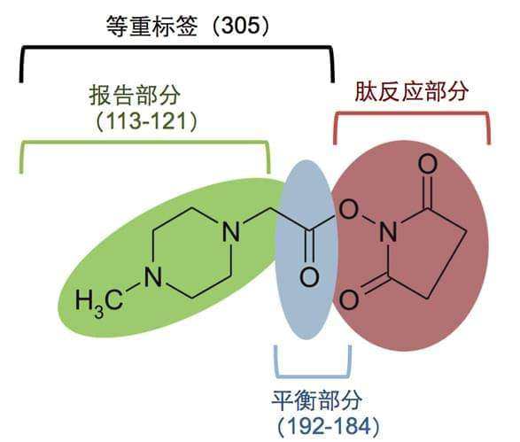
iTRAQ

Slide 86
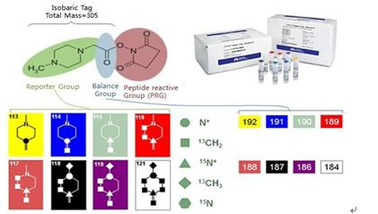
4-pixel iTRAQ

Slide 87
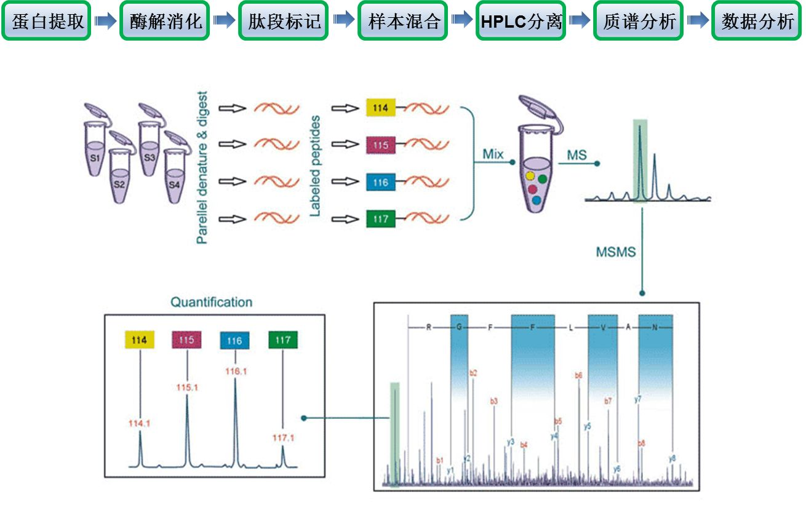
4-pixel iTRAQ

Slide 88

8-pixel iTRAQ

Slide 89

8-pixel iTRAQ

Slide 90

Tandem mass tags (TMT or TMTs)
TMT are Chemical labels used for mass spectrometry (MS)-based quantification and identification of biological macromolecules.
TMT belongs to a family of reagents referred to as isobaric mass tags.
Four regions
a mass reporter region (M)
a cleavable linker region (F)
a mass normalization region (N)
a protein reactive group (R)

Slide 91
Tandem mass tags (TMT or TMTs)
The combined M-F-N-R regions of the tags have the same total molecular weights and structure so that during chromatographic or electrophoretic separation and in single MS mode, molecules labelled with different tags are indistinguishable.
Upon fragmentation in, sequence information is obtained frMS/MS modeom fragmentation of the peptide back bone and quantification data are simultaneously obtained from fragmentation of the tags, giving rise to mass reporter ions

Slide 92
Tandem mass tags (TMT)
Four varieties of TMT available:
TMTzero, a non-isotopically substituted core structure;
TMTduplex, an isobaric pair of mass tags with a single isotopic substitution;
TMTsixplex, an isobaric set of six mass tags with five isotopic substitutions;
TMT 10-plex - a set of 10 isotopic mass tags which use the TMTsixplex reporter region, but use different elemental isotope to create a mass difference of 0.0063 Da

Slide 93


Slide 94


TMTsixplex

Slide 95

TMTtenplex

Slide 96

A schematic of isobaric labeling
protein extract, digest into peptides
labelling with Isobaric tags (TMT, iTRAQ）
mix
MS: the peptides appear as a single precursor
MS/MS: the reporter regions dissociate to produce ion signals which provide quantitative information
Notes:
Proteins are extracted from different conditions or cell types, digested into peptides, and labeled with isobaric stable isotope tags. These tags consist of reporter, balance, and reactive regions. Lighter reporter regions are paired with heavier balance regions, such that the entire tag attached to the peptide adds the same mass shift. Therefore, after mixing, in MS1, the peptides appear as a single precursor. However, when fragmented during MS2, in addition to the normal fragment ions, the reporter regions dissociate to produce ion signals which provide quantitative information regarding the relative amount of the peptide in the samples

Slide 97
Stable Isotope Labeling
According to labeling method
Metabolic labeling
Chemical labeling
Enzymatic labeling

Slide 98
In vitro labeling --proteolytic labeling --Trypsin catalyzed ¹⁶O-to-¹⁸O exchange
¹⁸O water
Cells A
extraction
reduction
alkylation
digestion
¹⁶O water
Cells B
separation
MS IDENTIFICATION and QUANTITATION
Stewart T. et al. R.ap. Comm.. Mass Spectrom. 15(24) 2456. (2001)
Yao XD et al. Anal. Chem.73(13):2836-2842. 2001

Slide 99
Proteolytic labeling
(Arg, Lys)
R₁
R₂
R₃
R₄
...NH-CH-CO-NH-CH-CO-NH-CH-CO-NH-CH-COOH
Trypsin /H₂¹⁶O
Trypsin /H₂¹⁸O
R₁
R₂
R₁
R₂
...NH-CH-CO-NH-CH-CO-¹⁶OH
...NH-CH-CO-NH-CH-CO-¹⁸OH
R₃
R₄
C-terminal labeled peptide
R₃
R₄
NH₂-CH-CO-NH-CH-COOH
NH₂-CH-CO-NH-CH-COOH
Enzymatic digestion in the presence of ¹⁸O-water or normal water
Incorporates ¹⁸O or ¹⁶O at the carboxyl-terminus of peptides

Slide 100
Enzymatic labeling versus ICAT
Enzymatic labeling
All peptides are labeled → higher coverage
In vivo labeling of proteins – not applicable to human studies
Easy detect ‘y’ ions
ICAT
Only cysteine containing peptides are labeled → reduce peptide complexity

Slide 101



Label Free Quantification ---SELDI(Surface Enhanced Laser Desorption Ionization)
Ionized proteins are detected and their mass accurately determined by Time-of-Flight Mass Spectrometry
a variation of matrix-assisted laser desorption/ionization (MALDI) that uses a target modified to achieve biochemical affinity with the analyte compound.
It combines chromatography,ProteinChip Systems with TOF-MS.
High throughput
Small amounts of sample
More reproducible than 2DE, but lower resolving power
Applied for the analysis of crude samples
Process is not standardized

Slide 102












ProteinChip Arrays
Chemical Surfaces
(Hydrophobic)
(Anionic)
(Cationic)
(Metal Ion)
(Normal Phase)
Biological Surfaces
(PS10 or PS20)
(Antibody - Antigen)
(Receptor - Ligand)
(DNA - Protein)

Slide 103

Protein Microarray
1. High throughput analysis of hundreds of thousands of proteins.
2. Proteins are immobilized on glass chip.
3. Various probes (protein, lipids, DNA, peptides, etc) are used.

Slide 104




SELDI Process
1. Add crude extract
2. Washing
3. Add EAM
4. Detection by TOF-MS
EAM = Energy absorbing molecule
copy from http://www.bmskorea.co.kr/new01_21-1.htm

Slide 105
Questions
What is differential proteomics? Why should we compare differential proteomes?
What are the main research techniques for differential proteome research? Which are gel dependent technologies and which are non gel dependent technologies?
Comparing 2D-DIGE & Two-in-one-gel
What are the stable isotope labeling techniques? How are they classified? What are the representative techbiques?
Comparing ICAT & iTRAQ Technology
What is SELDI technology?

Slide 106


